Slide 1



REVOLUTIONIZING EDUCATION WITH AI-DRIVEN BOOK SUMMARIZATION
Presented By,
Amritha V (811722104009)
Boomika T (811722104022)
Harinee M (811722104049)
Guided By,
Mrs Vallipriyadharshini
(M.E.(Ph.D))
DD/MM/YYYY

Slide 2
ABSTRACT
The education system is overloaded with extensive textual materials, making learning time-consuming and overwhelming.
This project introduces an AI-driven book summarization system to streamline learning.
Utilizes NLP and machine learning to automatically summarize academic content.
Aims to enhance comprehension, facilitate revision, and save time for students and educators.
DD/MM/YYYY

Slide 3
OBJECTIVE
Develop an AI-based tool for summarizing educational books.
Minimize cognitive load through concise summaries.
Improve comprehension and retention.
Implement NLP for extracting key ideas and information.
Create a scalable and adaptable system for different educational domains.
DD/MM/YYYY

Slide 4
LITERATURE SURVEY
S.No. | Paper Title | Year | Remark
1 | Transformer-Based Abstractive Summarization for Educational Content Compression: A Study on BART and T5 Models | 2024 | Demonstrates the effectiveness of transformer models (BART, T5) in educational content summarization.
2 | Enhancing Educational Accessibility through Natural Language Processing and AI Summarization Tools | 2023 | Highlights how NLP tools improve inclusivity and learning efficiency in education.
3 | An Extractive-Abstractive Approach for Multi-Document Summarization of Scientific Articles for Literature Review | 2022 | Combines both extractive and abstractive techniques to generate concise multi-document summaries for academic use.
DD/MM/YYYY

Slide 5
LITERATURE SURVEY
S.No. | Paper Title | Year | Remark
4 | SKT5SciSumm: Revisiting Extractive-Generative Approach for MultiDocument Scientific Summarization | 2022 | Proposes an enhanced extractive-generative hybrid summarization model for research literature.
5 | Multi-Document Summarization: A Survey of Evaluation Measures and Methods | 2022 | Provides an overview of evaluation metrics and techniques used in multi-document summarization systems.
6 | Context-AwareMulti-Document Summarization with Transformer Models | 2021 | Focuses on leveraging contextual understanding in transformer models for improved summarization accuracy.
DD/MM/YYYY

Slide 6
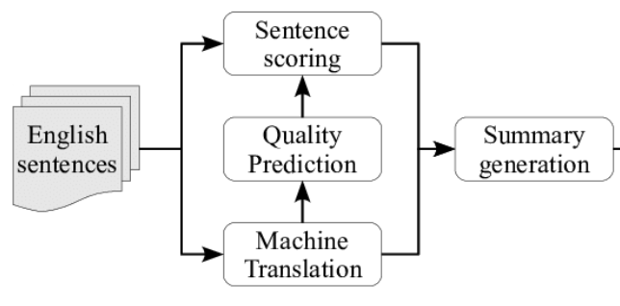
EXISTING SYSTEM
DD/MM/YYYY

Slide 7
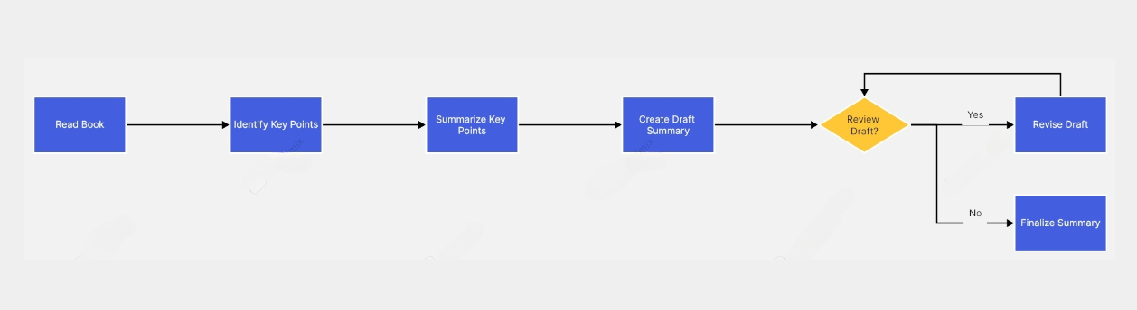
PROPOSED SYSTEM
DD/MM/YYYY

Slide 8
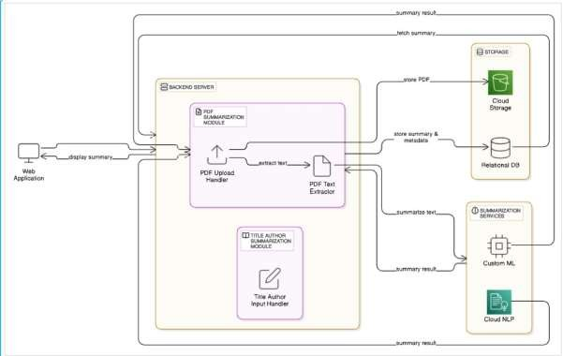
SYSTEM ARCHITECTURE
DD/MM/YYYY

Slide 9
MODULE 1 : Text Input
Purpose: To allow users to easily provide the content they want summarized in various formats.
Details:
Supports file uploads (PDF, Word, plain text), copy-paste, and URLs.
Automatically fetches and processes online content from URLs.
Validates inputs for format compatibility and correctness.
Cleans input text by removing unwanted characters and formatting issues before processing.
DD/MM/YYYY

Slide 10
MODULE 2 : Preprocessing
Purpose: To prepare raw text for effective summarization by cleaning and standardizing it.
Details:
Removes stop words, punctuation, special characters, and extra spaces to reduce noise.
Splits text into tokens (words or sentences) for easier analysis.
Applies stemming and lemmatization to normalize words to their base forms, improving summarization accuracy.
DD/MM/YYYY

Slide 11
MODULE 3 : Summarization Algorithm
Purpose: To generate concise, meaningful summaries that capture the core ideas of the original text.
Details:
Uses advanced NLP models for two summarization types:
Extractive: selects key sentences directly from the text.
Abstractive: creates new sentences that paraphrase the content.
Employs pre-trained models like BART and T5, fine-tuned for educational texts.
Produces summaries that retain essential meaning with reduced length.
DD/MM/YYYY

Slide 12
MODULE 4 : Keyword Extraction & Concept Mapping
Purpose: To highlight important terms and visually show relationships between concepts for better understanding.
Details:
Extracts keywords using TF-IDF and Named Entity Recognition (NER) to identify critical terms and entities.
Identifies categories such as people, places, dates, and organizations.
Creates concept maps that graphically represent connections between key ideas, aiding comprehension especially for visual learners.
DD/MM/YYYY

Slide 13
MODULE 5 : User Interface
Purpose: To ensure a smooth, intuitive, and engaging user experience with easy navigation and controls.
Details:
Minimalist and clean layout emphasizing usability.
Interactive elements (buttons, sliders, dropdowns) for controlling summary length, style, and accessibility settings.
Quick access to all core functions: input, summary, keywords, and personalization.
DD/MM/YYYY

Slide 14
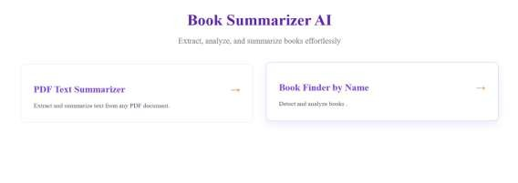
OUTPUT
DD/MM/YYYY

Slide 15
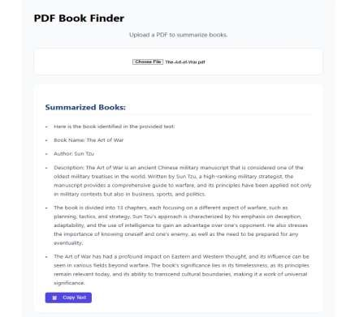
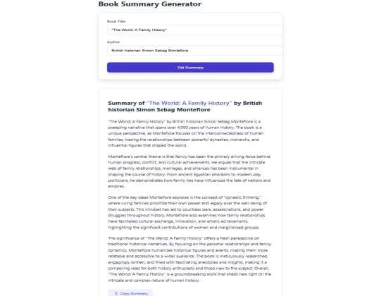
OUTPUT
DD/MM/YYYY

Slide 16
CONCLUSION & FUTURE ENHANCEMENT
The AI-Driven Book Summarization System presents a transformative solution for modern education by simplifying the way students and professionals consume information. Through intelligent modules—ranging from advanced text input handling and preprocessing to powerful NLP-based summarization, keyword extraction, and personalized accessibility features—the system significantly reduces the time and effort needed to understand large volumes of content.
Future Enhancement:
Add support for multiple languages.
Create a mobile application version.
Include speech-to-text for voice input summarization.
Integrate personalized content recommendations.
Improve summarization accuracy with domain-specific training.
DD/MM/YYYY

Slide 17
REFERENCES
Enhancing Educational Accessibility through Natural Language Processing and AI Summarization Tools Makenzie Gilkison, Nadine Gilkison, Alexis Reid, Paul Sanft (2023)
Sajja, R., Sermet, Y., Cikmaz, M., Cwiertny, D., & Demir, I. (2023). Artificial Intelligence-Enabled Intelligent Assistant for Personalized and Adaptive Learning in Higher Education. Education and Information Technologies.
Pinto, P. G., Arantes, L. P. R., & Ochoa, F. A. G. (2022). A Hybrid Model for Extractive and Abstractive Summarization of Scientific Papers.
In Proceedings of the International Conference on Artificial Intelligence. 4. Multi-Document Summarization: A Survey of Evaluation Measures and Methods R. Barrios, M. Gelbukh, G. K. S. M. Ali (2022)
Barrios, R., Gelbukh, M., & Ali, G. K. S. M. (2021). Multi-Document Summarization: A Survey of Evaluation Measures and Methods. Information Processing & Management, 58(3), 102466.
DD/MM/YYYY

Slide 18

DD/MM/YYYY

